Slide 1
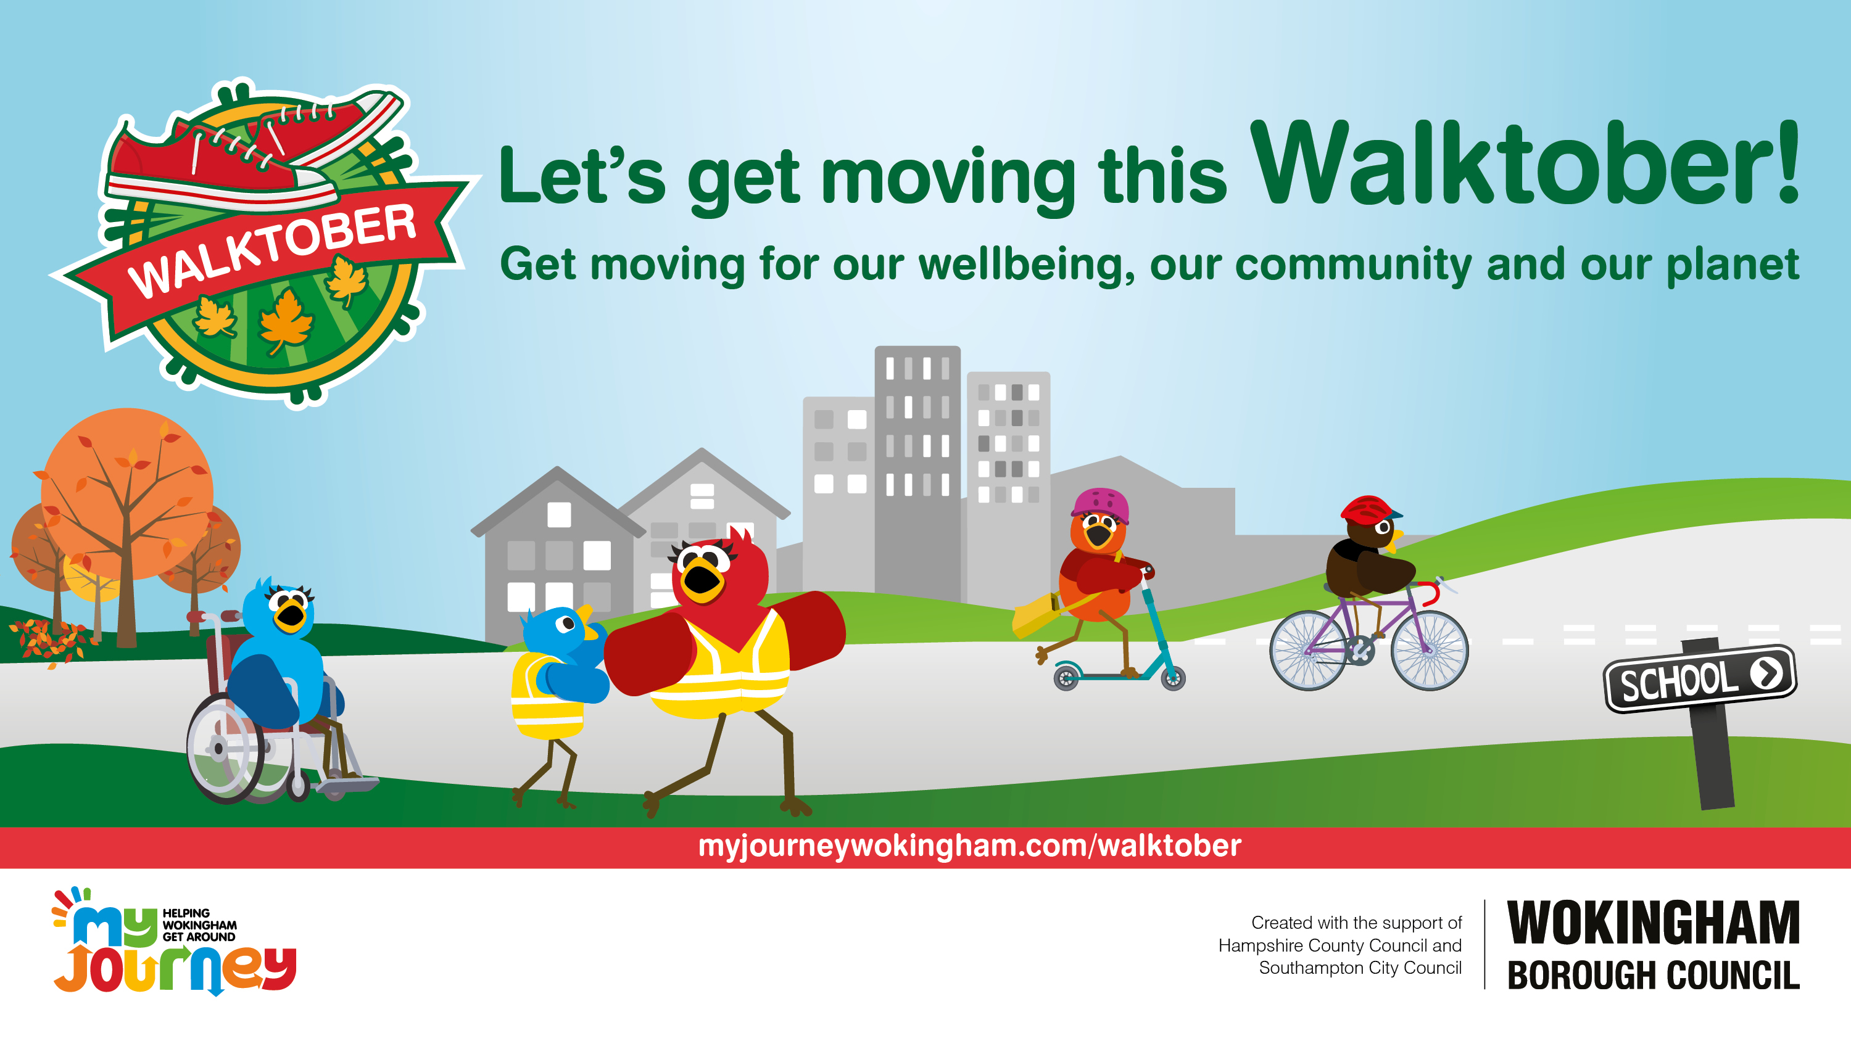

Slide 2
What is Walktober?
Walktober is an active travel challenge held each October to celebrate
International Walk to School Month.
For Walktober, we are encouraging pupils, families and staff to
‘Get Moving’ by travelling actively and sustainably as often as possible.
By taking part in Walktober, your school will help make a change for
our wellbeing, our community and our planet.
Notes:
Thank you for taking part in Walktober 2025!

Slide 3
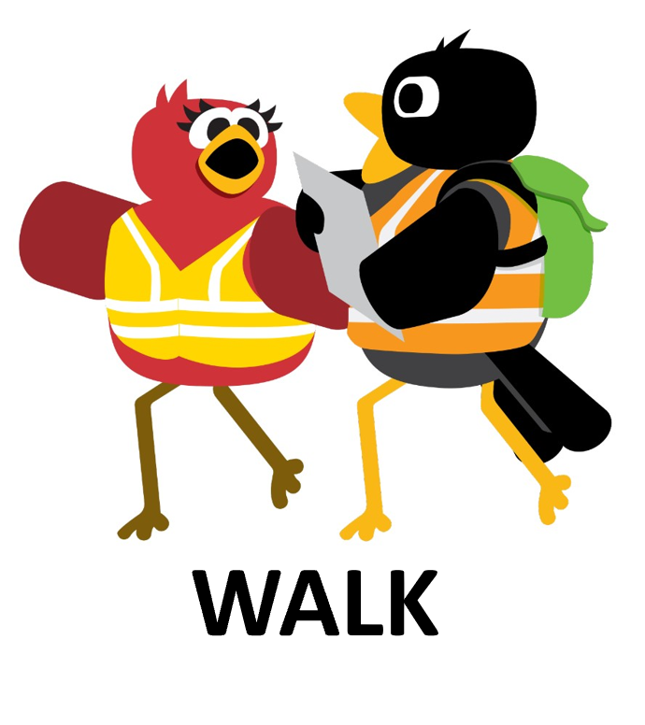
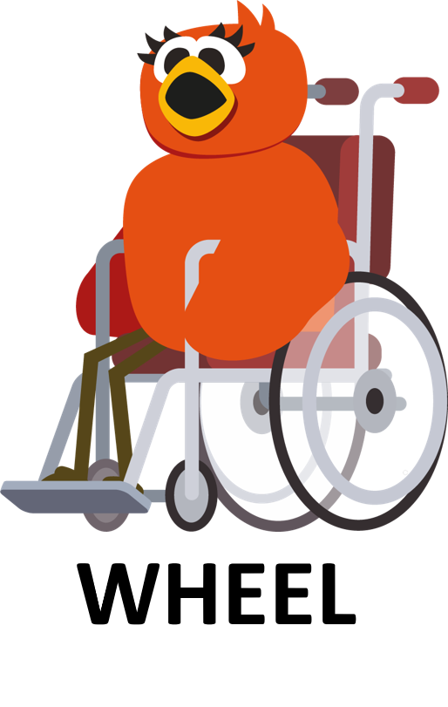

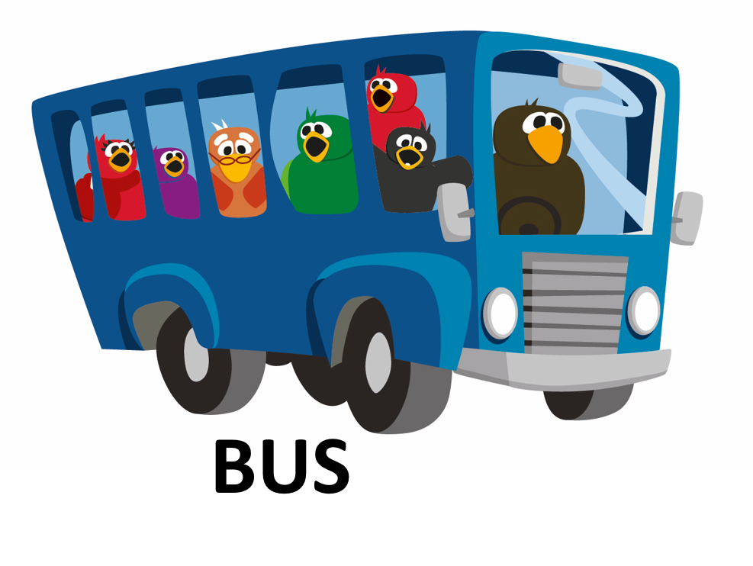
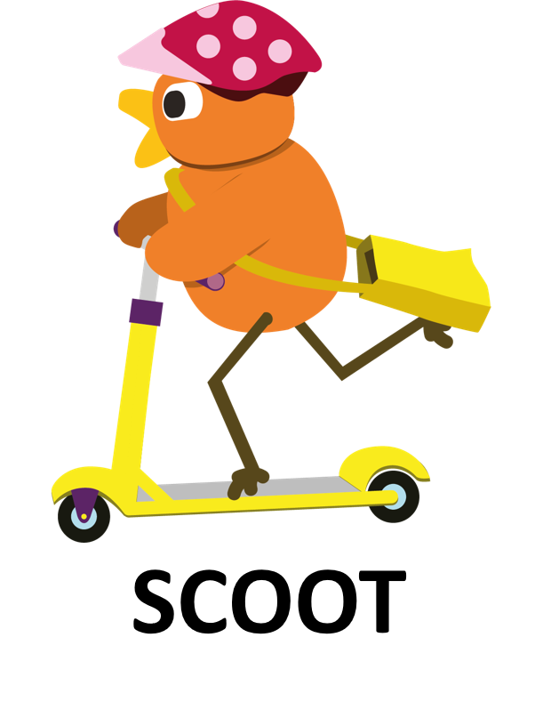
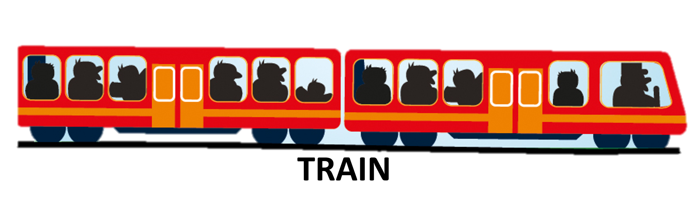
What is sustainable and active travel?
Notes:
Where possible, leave the car at home and choose a more active and environmentally friendly way to make your journeys:
Walk,
Wheel,
Scoot,
Cycle,
Bus,
Train.

Slide 4

What if I have to travel by car?
PARK & STRIDE
Travel part of the way by car.
Park 5 -10 minutes from your destination.
Walk, wheel or scoot the rest of the journey.
When choosing a place to park, make sure it is legal, safe and considerate of local residents and businesses.
Notes:
Ask the children - If it is too far to travel actively the whole way and using the bus or train isn’t an option for that journey, how could they still benefit from some activity in their journey?
Park and Stride, travel part-way by car, find a safe and considerate place to park and then travel actively for the last part of the journey.
Park or get dropped off at a more local friend’s house and walk/wheel the rest of the way with them.
Lots of schools have local Park and Stride such as pubs, community centres, village halls etc.
If your school does not have a Park and Stride, why not look at possible sites or you can perhaps encourage your school community to side street park (legally and considerately).

Slide 5
Get moving for Walktober!
Our community
Our planet
Our wellbeing
Travelling actively and sustainably is good for:
  Our wellbeing,
  Our community,
  Our planet.
Get moving for Walktober and you can make
an impact on all three!
Plus, there is a great competition to enter!
Notes:
Ask the children how they think walking, wheeling, scooting and cycling benefits:
Their wellbeing (mental and physical health),
Their community,
The planet.

Slide 6
Our wellbeing
Exercise is great for our bodies and brains! By travelling actively, you are fitting exercise into your daily routine without even realising it!
Spending time in nature is great for our mental health, releasing ‘feel good’ hormones called endorphins.
Travelling actively all or part of the way wakes us up and makes us ready and alert for learning. Teachers will be pleased! It also helps us to sleep better at night.
It gives us time to chat with friends and family and talk about any worries.

Slide 7
Our Community
When we leave our cars at home, our streets are busier with people – there is a good buzz! Think how nice it is walking, wheeling, scooting or cycling and seeing other people!
Travelling actively allows us time to get to know our neighbours. This doesn’t happen when we are in our car!
It connects people – lots of people make friends, for example while out walking in the park.
Less congestion near the school and in the local area is nicer and safer for everyone.
It means the air is cleaner too!

Slide 8
Our planet
Cars and vehicles produce pollution when they burn fuel.
By walking, wheeling, scooting or cycling rather than using the car, you create less pollution.
Cleaner air helps to keep the Earth’s temperature stable.
The right temperature and clean water is so important for our plants
and animals.
Notes:
As a school decide if you would like pupils to complete a paper copy of the Walktober Activity Card and if so, print for each pupil taking part in Walktober.
The Walktober Activity Card can also be completed on a computer. If this is your preferred choice, email the pupil Activity Card to parents and carers.
Pupil’s parents and carers submit their Walktober Activity Card as their competition entry by email to myjourney@wokingham.gov.uk using the subject title ‘Walktober 2025’.

Slide 9
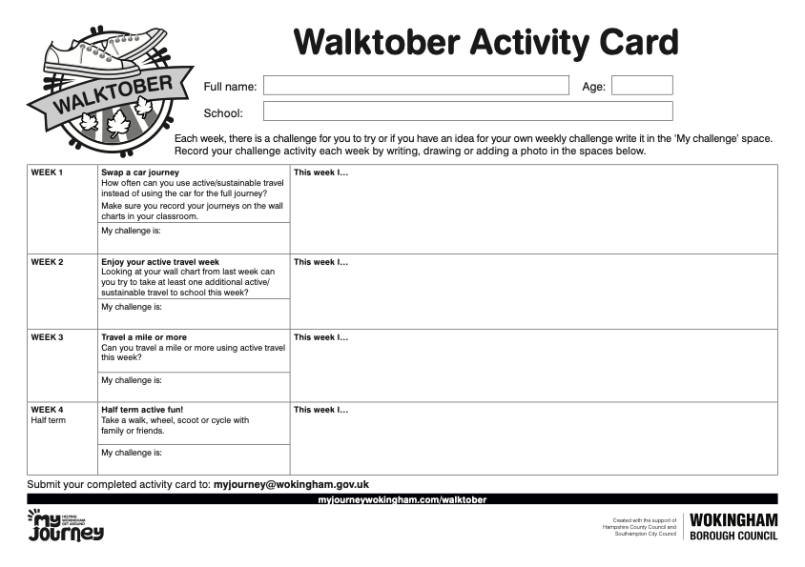
Walktober pupil competition
What should I include in my Walktober Activity Card?
How you travelled to school – walking, wheeling, scooting, cycling, bus, train or using Park and Stride.
Is it different to your usual way of travelling? If so, what did you enjoy about it and describe how it makes you feel?
Or if you travel that way most days, tell us what you love about your journey and how it makes you feel.
Any tips you would give others to make their journeys become more active and sustainable, especially if you solve any challenges.
You could win a prize for your entry!

Slide 10
Walktober schools competition
Support pupils in creating their Walktober activity cards, either at home or in school.
Pupil’s activity cards can be shared with others at school and entered into the pupil competition.
Encourage staff who travel to work actively or sustainably to create a short story or report about their journey to share with the school community.
Ask parents and carers with regular or new active and sustainable journeys if they
could share their story to help inspire others.

Slide 11
Walktober school competition
Decide how to showcase your school community’s inspirational Walktober journeys.
Ideas include:
• Newsletter articles
• Social media posts
• A website feature
• A school display
• During an assembly
• In circle time
• As part of a class lesson
• Inviting ‘guest speakers’ into school
At the end of Walktober, log all your activities using the Walktober competition entry form.
You can include a written summary, photos, screenshots, quotes or links - be as creative as you like!

Slide 12

Your actions DO make a difference!
You may think ‘I am just one person, how do I make a difference?’
But, think about all the other people in your school taking part in Walktober.
Then think about all the other schools taking part – there are 100’s of schools taking part in Walktober across the country!
It helps you realise that by working together, our collective actions DO make a BIG difference!

Slide 13


